Slide 1
GENDER PREDICTION
Using Machine Learning Techniques
Presented By : Karan Gupta
Institute : IT Vedant
Course : DS&DA
Branch : Thane

Slide 2
Steps
Define the Problem(Problem Statement: Classification.
Data Loading.
Exploratory Data Analysis(EDA):-
Identification of variables and data types.
Missing value treatment
Graphical Univariate Analysis
Label Encoder
Separation of x and y
Train Test Split
Choose a Model
Train the Model
Evaluate the Model
Model Deployment

Slide 3
Problem Statement
Gender prediction is a fundamental task in machine learning with various applications in fields such as marketing, healthcare, and social sciences.
The objective of this project is to develop a robust predictive model that accurately predicts the gender of individuals based on relevant data.

Slide 4
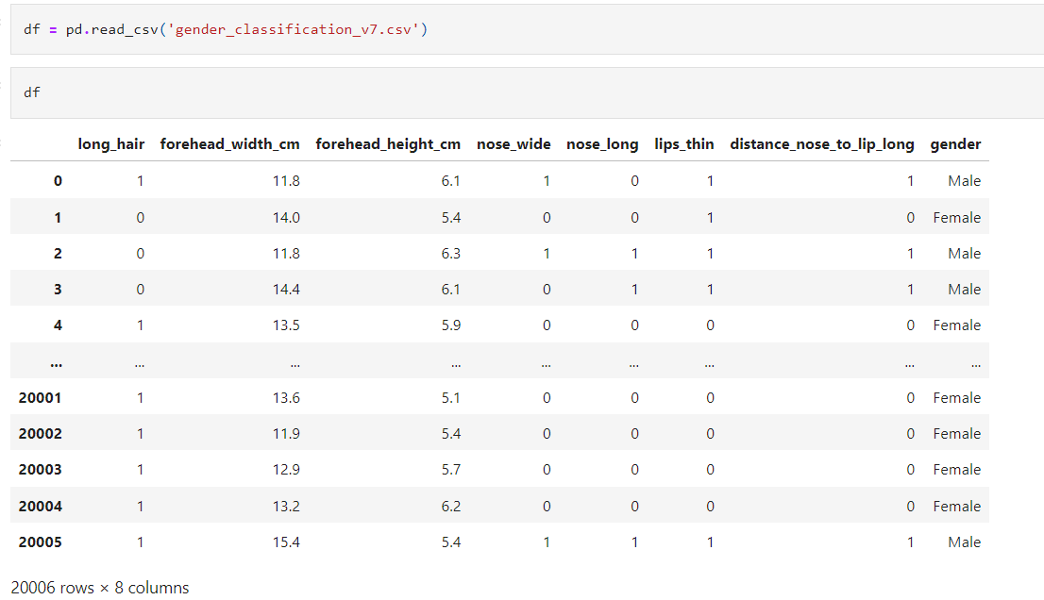
Data Collection

Slide 5
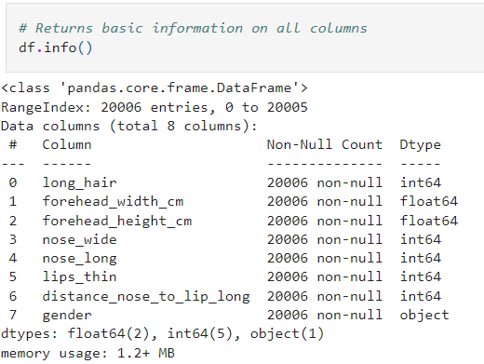
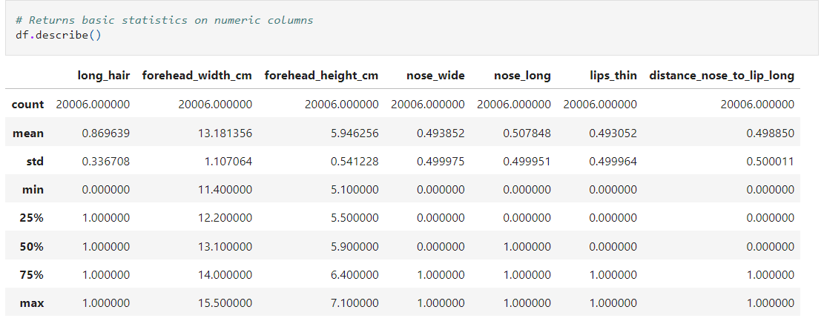
EDA
Identification of Variables and data types
Non-Graphical Univariate Analysis

Slide 6
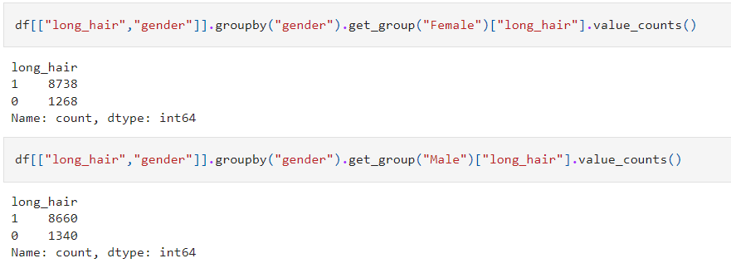
Data Visualization
Counts using Long Hair

Slide 7
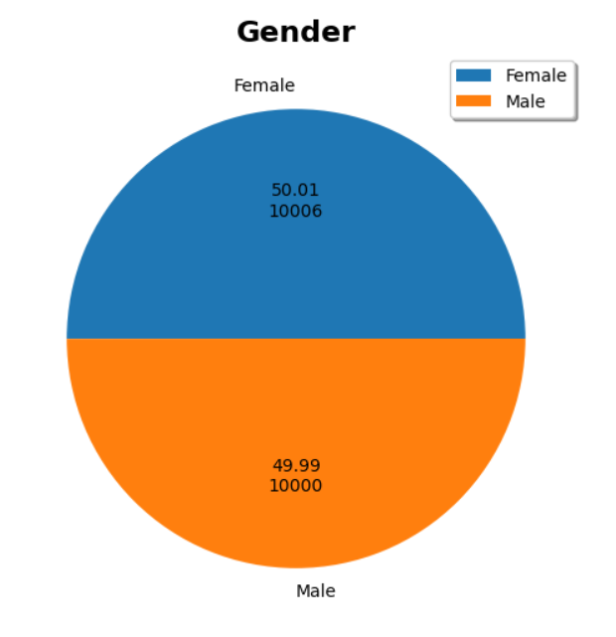
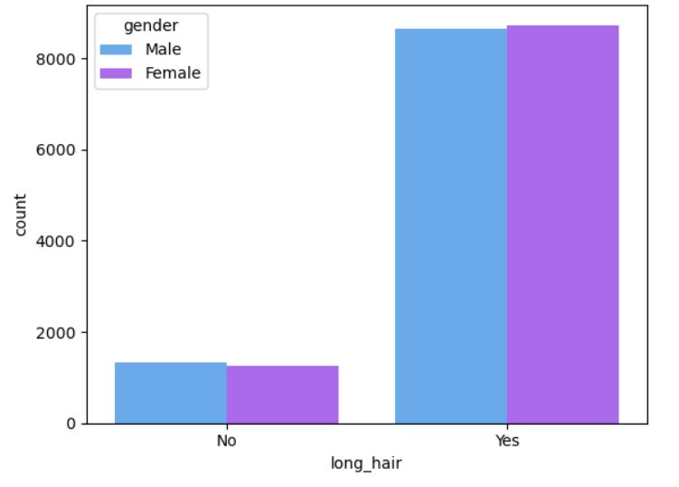
Graphical Representation
Gender
Long Hair

Slide 8
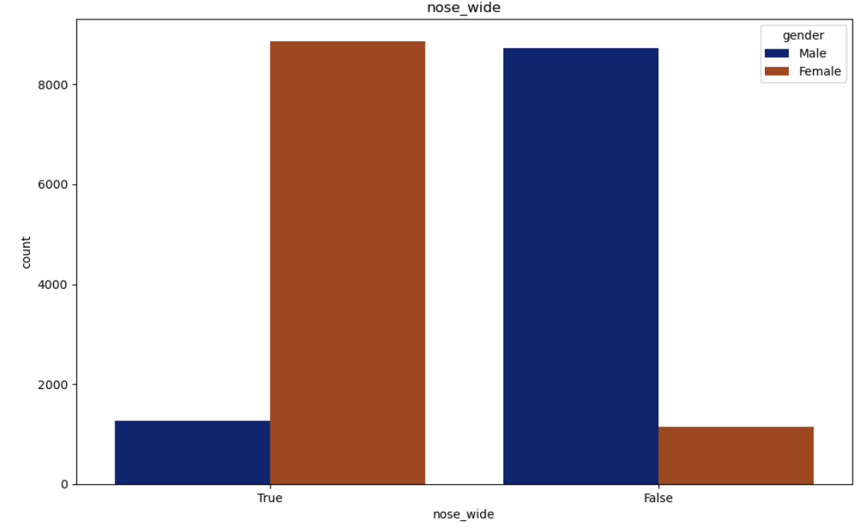
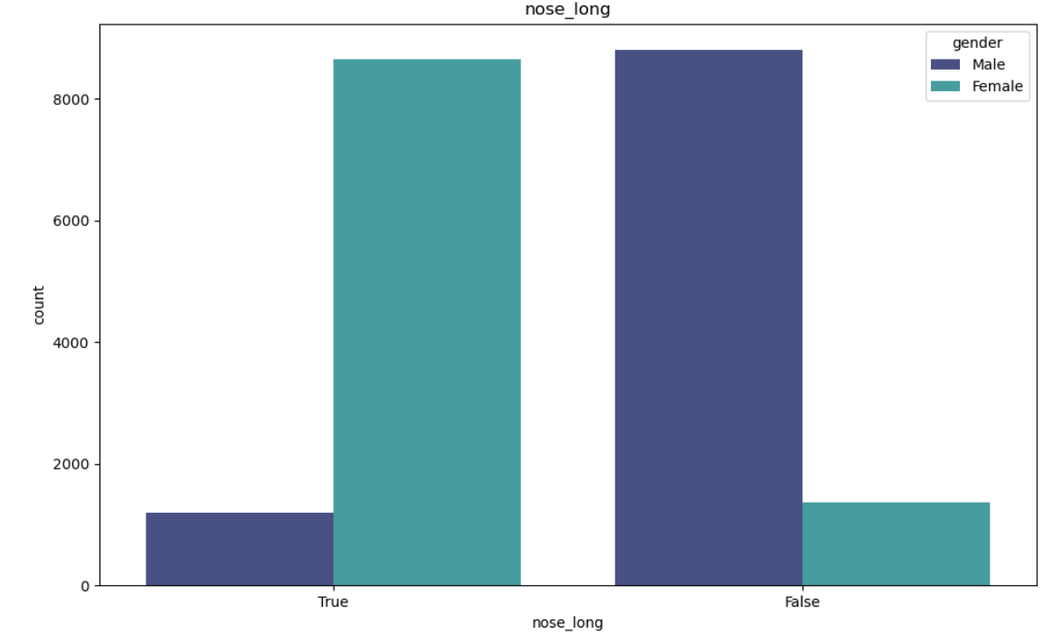
Nose Wide
Nose Long

Slide 9
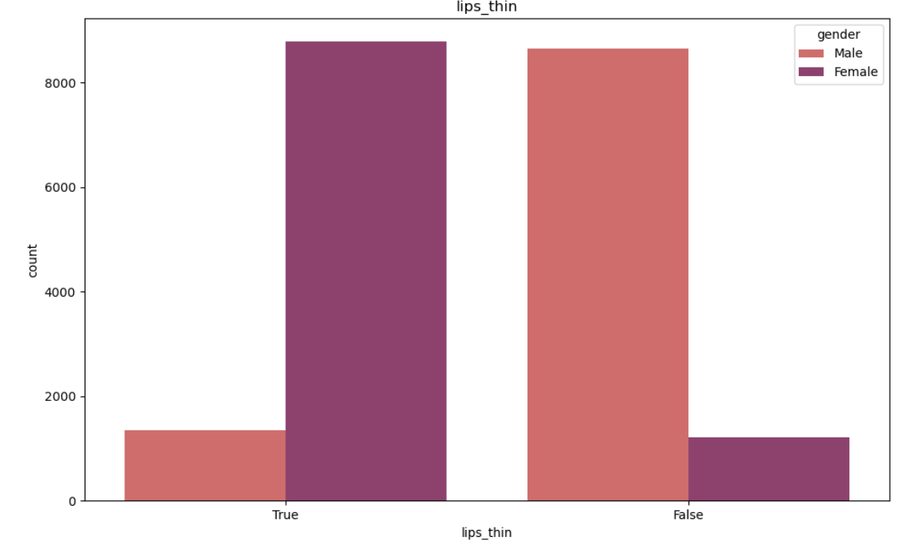
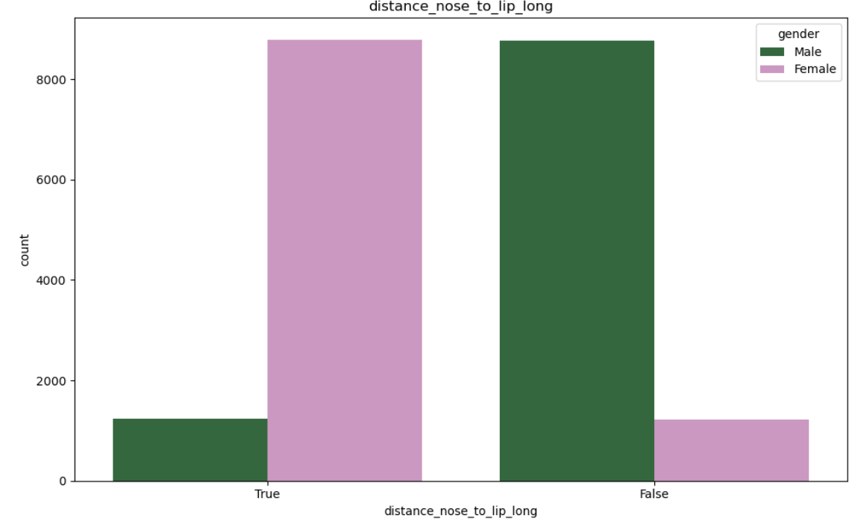
Lips Thin
Distance Nose to Lip Long

Slide 10
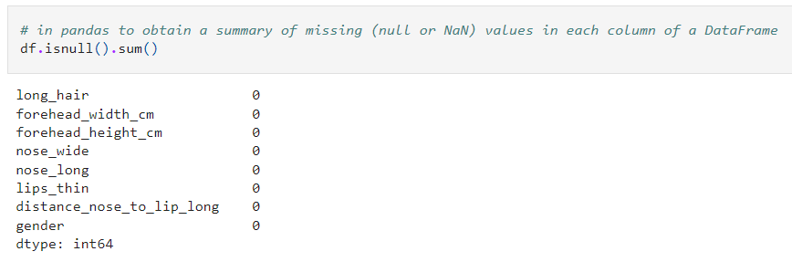
DATA CLEANING
Null Values

Slide 11
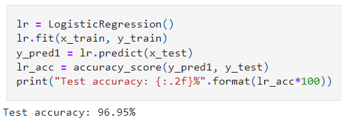
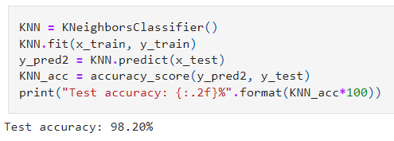
MODEL BUILDING
Logistic Regression
Kneighbors Classifier

Slide 12
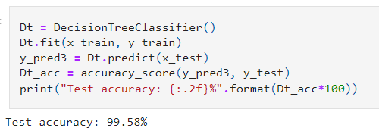
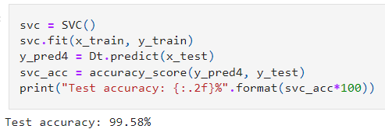
DecisionTree Classifier
SVC

Slide 13
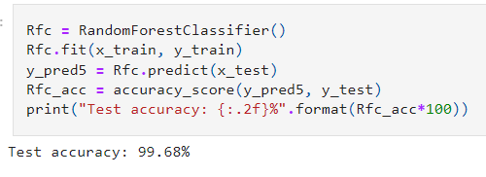
RandomForest Classifier

Slide 14
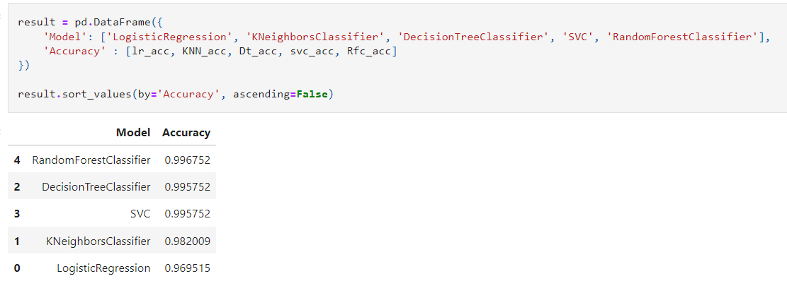
ALL MODEL IN ONE DATAFRAME

Slide 15
CONCLUSION
The order of the Best Models Accuracy from top to bottom is : RandomForest Classifier

Slide 16
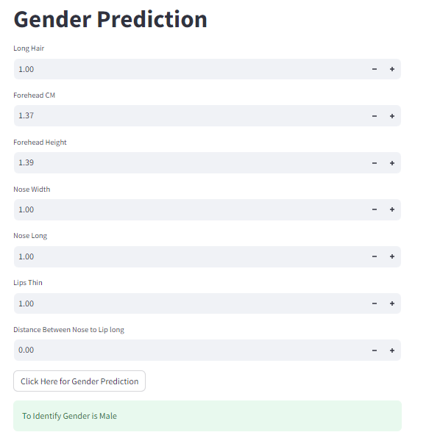
DEPLOYMENT
Tools and Libraries used-
Anaconda Navigator : Environment Creation
Pickle : Binary Conversion of data
Stream lit : Web App
Scikit-Learn : RandomForest Classifier Model

